Slide 1

Smoking Health Risk Analysis
Team Leader : Yasmen Hassan Sayed
Merola Medhat Momtaz
Salma Yasser Khalaf
Esraa Ali Osman
Mohraiel Maher
Date : 5-7-2026

Slide 2
Smoking Analysis
Problem Statement
Smoking has become increasingly about 60% widespread in various forms, including traditional cigarettes, vaping, and other tobacco products. These habits significantly increase the risk of developing serious health conditions such as cancer, lung diseases, high cholesterol, and obesity-related complications (high BMI).
The percentage of smokers attempting to quit is 15%, which is an extremely low figure .
Despite growing awareness of these health risks, many smokers struggle to quit due to nicotine addiction, repeated unsuccessful attempts, and the high cost or limited accessibility of effective smoking cessation programs. As a result, there is a need for an accessible solution that helps individuals better understand their health risks while supporting them throughout their journey toward quitting smoking.

Slide 3
Overview of the Proposed Solution
Develop a web-based platform that supports smokers throughout their smoking cessation journey.
Provide a personalized quitting plan that guides users step by step over 3–6 months.
Offer daily and weekly follow-ups to monitor progress and keep users motivated.
Create customized healthy lifestyle routines, including nutrition, hydration, sleep, and physical activity recommendations.
Encourage users to undergo regular medical checkups and screenings to monitor their health and support the early detection of smoking-related diseases, including cancer.
Provide continuous psychological support to help users overcome nicotine addiction, manage withdrawal symptoms, and maintain motivation.
Apply a gradual smoking reduction strategy, aiming to reduce cigarette consumption by approximately 2 cigarettes per week to reduce The 8 Cigrattes Per Day , making the quitting process more achievable and sustainable.
Track user progress through an interactive dashboard, allowing users to monitor their achievements and stay engaged throughout their journey.
.

Slide 4
Unique Value Proposition (UVP)
1-Multidisciplinary medical support, including:
1-Chest specialist for lung health assessment.
2-Internal medicine specialist for overall health evaluation.
3-Nutritionist for personalized diet plans.
4-Psychologist for emotional support and addiction management
2-All-in-one platform that combines smoking cessation, health monitoring, and early disease prevention in a single website.
3-Personalized 3–6 month quitting program with step-by-step guidance tailored to each user's progress.
4-Continuous follow-up and progress tracking through daily and weekly monitoring to keep users motivated and committed.
.
.

Slide 5
Unique Value Proposition (UVP)
5-Medical test and screening recommendations based on the user's condition, helping them know exactly which examinations to undergo.
7-Smoking alternatives and practical quitting strategies to reduce nicotine dependence gradually and sustainably.
8-Personalized healthy lifestyle plans, including nutrition, hydration, sleep, and physical activity recommendations.
9-Strong focus on early cancer detection, encouraging preventive screening and timely medical intervention to improve health outcomes.
10- An artificial intelligence system and Prediction to assist patients with the early detection of cancer or any smoking-related disease.
.

Slide 6
primary user personas : Smokers (nicotine and Alcohol) who wants to quit smoking and improve health.
Key Features that address user needs :
1-Quit Smoking Plan
2-Daily Tracking
3-AI Analysis & Prediction
4- Early detection of cancer
-5Upload Medical Scans
6-Nutrition Plan & balanced diet
7-Psychological Support
8-Reminder Notifications
.

Slide 7
how the features solve the problems of each end-user :
1-Quit Smoking Plan : help smoker to quit smoking By reducing 2 Cigrattes per week and about 3 month the smoker will completely quit smoking.
2-Daily Tracking : Daily and weekly follow-up.
3-AI Analysis & Prediction : calculate the risk score and avoided the risk of Lung’damaged , hypertension , cholesterol level and BMI .
4- Early detection of cancer : avoided Lung Cancer that result of smoking.
.

Slide 8
how the features solve the problems of each end-user :
5-Upload Medical Scans : It assists in analyzing and reviewing medical images and reminds you of scheduled check-ups every 3 or 6 months.
6-Nutrition Plan & balanced diet :Implementing a comprehensive nutritional plan from food , drinks and sleep that includes real-time monitoring and a regular exercise routine.
7-Psychological Support : Ongoing psychological support to overcome this difficult period.
8-Reminder Notifications : Sending continuous notifications to remind of appointments.
.

Slide 9
Scientific References Health & Smoking Dataset
1- WHO — World Health Organization (Tobacco and Cancer Fact Sheet (2023) )
https://www.who.int/news-room/fact-sheets/detail/tobacco
2- Gandini S. et al. (2008) Tobacco Smoking and Cancer: A Meta-Analysis European Journal of Cancer, 44(8): 1293–1301
https://doi.org/10.1016/j.ejca.2007.12.026
3- Doll R. & Peto R. (1976) Mortality in Relation to Smoking: 20 Years' Observations British Medical Journal
https://doi.org/10.1136/bmj.2.6051.1525
.

Slide 10
Scientific References Health & Smoking Dataset
4- NCI — National Cancer Institute (USA) SEER Database
https://www.who.int/news-room/fact-sheets/detail/tobacco
5- Slaughter D.P. et al. (1953) Field Cancerization in Oral Stratified Squamous Epithelium Cancer, 6(5)
https://doi.org/10.1002/1097-0142(19530901)6:5
6- IARC — GLOBOCAN 2020 Global Cancer Observatory — Worldwide Incidence Statistics
https://gco.iarc.fr/
.

Slide 11
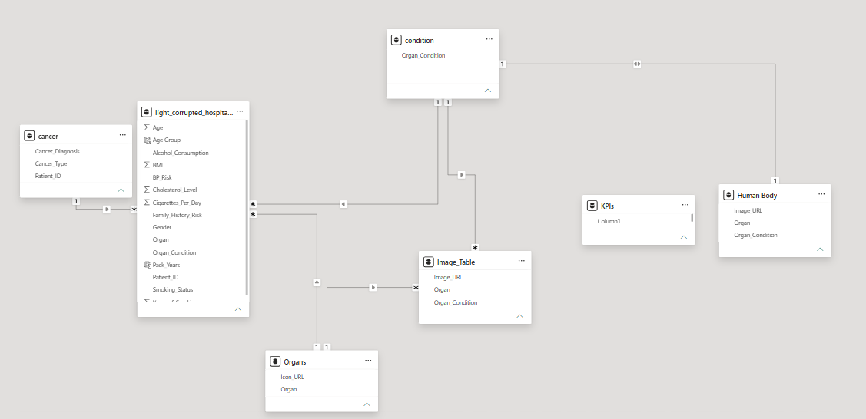
More details about dataset
-30,000 Rows
- 18 columns
-Imbalanced data
(num of smoker !=
num of nonsmokers)
-The relationships
between Tables :-
.

Slide 12
Data cleaning :
The dataset was cleaned and transformed using Power Query to improve data quality and ensure accurate analysis.
Promoted Headers : Set the first row as column headers .
Changed Type : Assigned the correct data type to each column
Removed Duplicates :Removed duplicate records to ensure data uniqueness.
Replaced Value : Standardized inconsistent values and handled missing or invalid entries.
Cleaned Text : Removed hidden and non printable characters from text values .
.

Slide 13
Programming Languages
• Python
Frameworks & Libraries
• Excel • power bi
• power query • Matplotlib & Seaborn
• Pandas • NumPy
• Scikit-learn • XGBoost
• LightGBM • CatBoost
• SMOTE (Imbalanced-learn) • Joblib
• TQDM • Streamlit
Supporting Technologies
• Gemini • Git & GitHub
.

Slide 14
Project Deliverables:-
1. Interactive Power BI Dashboard
A fully interactive Power BI dashboard designed to support healthcare professionals in monitoring patient health, identifying high-risk individuals, and analyzing cancer-related risk factors.
The dashboard consists of four interactive pages:
Overview Dashboard
Smoking Analysis Dashboard
Risk Assessment Dashboard
Cancer Insights Dashboard
The dashboards includes:
1-Interactive KPIs 2-Custom DAX Measures
3-Dynamic Charts & Visualizations 4-Slicers and Filters
5-Drill-through & Cross-filtering capabilities
.

Slide 15
Project Deliverables:-
2. Prediction Model with machine learning
A machine learning model capable of predicting the likelihood of cancer diagnosis based on patient demographic, lifestyle, and medical characteristics.
The model provides:
Cancer prediction
Risk classification
.

Slide 16
Project Deliverables:-
3. Smoking Recovery Website
A user-friendly website developed specifically for smokers to support their smoking cessation journey.
The website provides (UVP) :
Personalized risk assessment
Smoking habit tracking
Educational content about smoking-related diseases
Health improvement recommendations
Motivation and recovery guidance
Access to the prediction model for estimating individual cancer risk
.

Slide 17
OverView Page
Insight | Description
Insight 1 | The 39–48 years age group represents the largest proportion of patients in the dataset
Insight 2 | Former smokers consumed an average of 8 cigarettes per day, suggesting that smoking intensity remains relatively high before quitting
Insight 3 | Approximately 30% of patients exhibit lifestyle-related risk factors based on smoking exposure
Insight 4 | The average Pack-Year score is 4.8, indicating the cumulative impact of smoking duration and daily cigarette consumption
Insight 5 | Only 15% of the analyzed population are former smokers, indicating that a relatively small proportion of smokers successfully quit smoking
Insight 6 | The funnel shows a clear reduction from 30,000 patients to 11,000 heavy smokers, and finally to 9,000 diagnosed cancer cases
Insight 7 | The dataset is concentrated in the middle-aged population, with younger and older age groups representing smaller proportions
Insight 8 | Patients remain in the heavy smoking stage for a considerable period before reaching cancer diagnosis, highlighting an important window for early intervention
Insight 9 | The combination of age and smoking history appears to be a stronger indicator of health deterioration than either factor alone
Insight 10 | The dashboard emphasizes that quitting smoking is only the first step. Continuous monitoring, personalized recommendations, and early medical screening are essential to reduce long-term cancer risk.
.

Slide 18
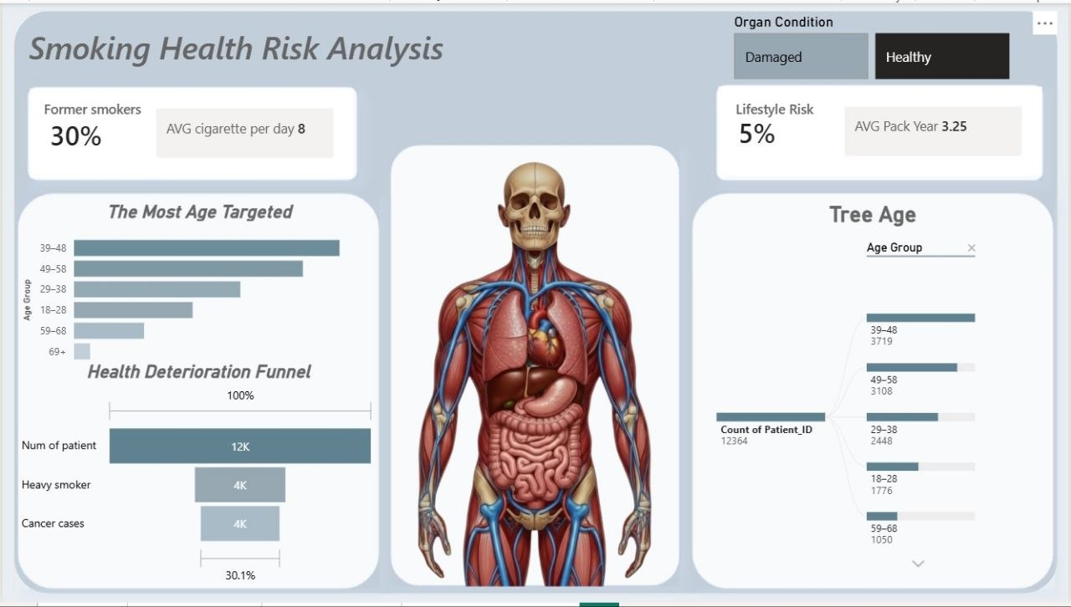
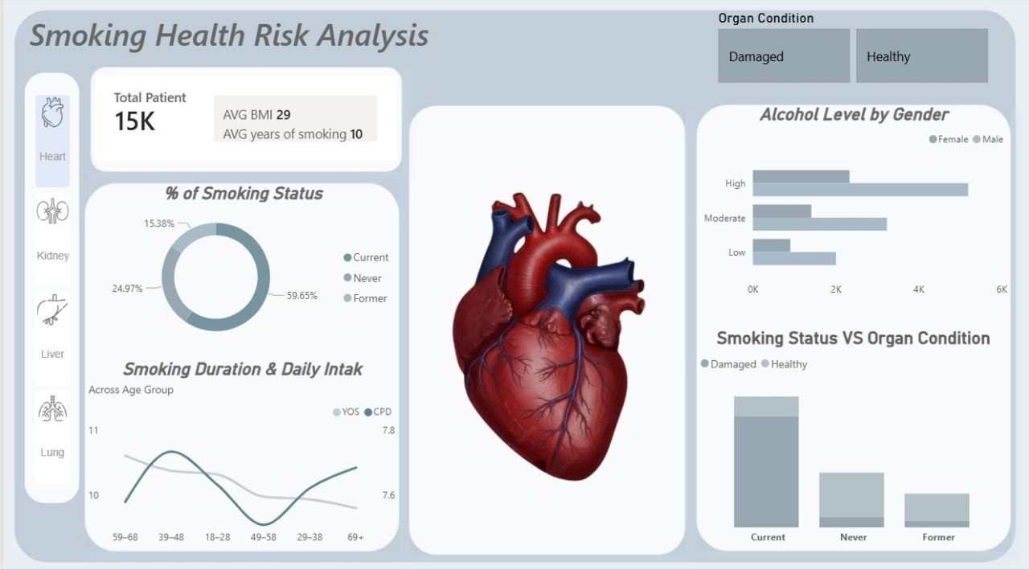
.

Slide 19
Smoking Analysis Page
Insight | Description
Insight 1 | Smoking does not affect a single organ; it impacts multiple body systems. Therefore, healthcare providers should evaluate smokers using a multi-organ assessment rather than focusing only on lung diseases.
Insight 2 | Current smokers account for approximately 60% of the analyzed population, and this is high percentage and should reduce it.
Insight 3 | Smoking duration and daily cigarette consumption differ between age groups, with middle-aged individuals showing the highest exposure.
Insight 4 | Patients with higher alcohol consumption also tend to present higher smoking-related health risks.
Insight 5 | The average smoking duration is approximately 10 years, indicating prolonged exposure to tobacco among many patients .
Insight 6 | The dashboard allows users to explore smoking-related impacts across the heart, lungs, liver, and kidneys, demonstrating that smoking is a systemic health risk .
Insight 7 | Heavy smokers should be considered the highest-priority group for preventive healthcare because they combine long smoking duration with high daily cigarette consumption .
Insight 8 | The dashboard highlights that lifestyle factors should not be evaluated individually . Smoking, alcohol consumption, BMI, and organ health together provide a more accurate assessment of patient risk
Insight 9 | The dashboard identifies users who are most likely to benefit from personalized intervention before severe complications occur .
Insight 10 | The relationship between smoking status and organ condition suggests that quitting smoking may help reduce future organ deterioration .
.

Slide 20
Risk Page
Insight | Description
Insight 1 | Individuals aged 69+ years (order people) show the highest combination of cholesterol and hypertension risk .
Insight 2 | Around 70% of high-risk patients have a positive family history and This is considered a high and alarming rate, indicating that smokers pass on bad habits to their children.
Insight 3 | Patients with a positive family history experience a noticeably higher number of cancer diagnoses than those without a family history.
Insight 4 | Heavy smoking alone does not fully explain patient risk. Individuals with additional risk factors such as family history, hypertension, elevated cholesterol, and alcohol consumption face substantially greater health risks .
Insight 5 | The largest proportion of patients falls within the Normal BP category, while a considerable number are already classified as High Risk.
Insight 6 | Patients with higher alcohol consumption tend to present a higher proportion of elevated blood pressure risk .
Insight 7 | Nearly two-thirds of smokers are classified as heavy smokers 66 % , reflecting prolonged and intensive tobacco exposure.
Insight 8 | Almost 59% of analyzed lungs are already classified as damaged .
Insight 9 | Approximately 60% of the analyzed patients are classified as high-risk, indicating that more than half of the population requires preventive healthcare interventions .
.

Slide 21
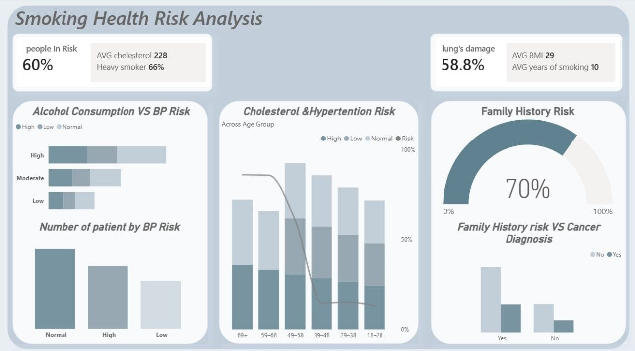
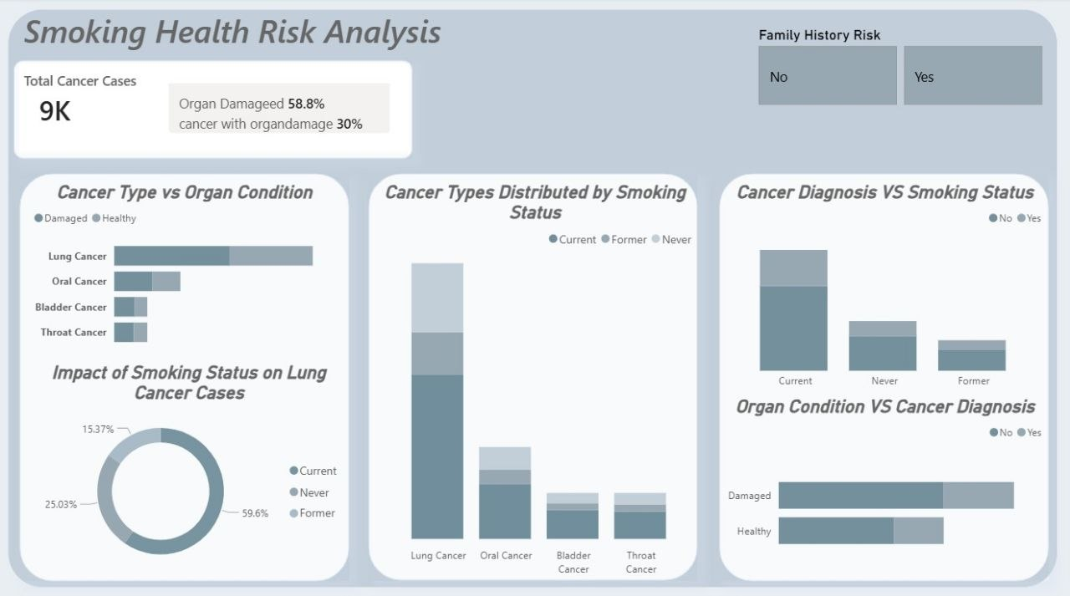
.

Slide 22
Cancer Page
Insight | Description
Insight 1 | The dataset contains approximately 9,000 diagnosed cancer cases it represent 30 % , it represent shifting healthcare strategies from treatment toward early detection and prevention, particularly for high-risk individuals .
Insight 2 | Nearly 59% of patients have damaged organs, and 30% of cancer cases occur among individuals with organ damage .
Insight 3 | Patients with damaged organs consistently show higher cancer incidence than those with healthy organs, with lung cancer being the most common cancer type .
Insight 4 | Current smokers account for the highest number of cancer cases across nearly all cancer types, particularly lung cancer .
Insight 5 | Cancer diagnoses are significantly more frequent among current smokers than among former or never smokers .
Insight 6 | Patients with damaged organs have a considerably higher number of cancer diagnoses compared with patients whose organs remain healthy .
Insight 7 | Current smokers experience the highest number of lung cancer cases, exceeding both former and never smokers by a significant margin .
Insight 8 | The Family History filter allows healthcare professionals to compare cancer patterns between patients with and without genetic predisposition .
Insight 9 | Former smokers consistently show fewer cancer cases than current smokers across all cancer types .
.

Slide 23
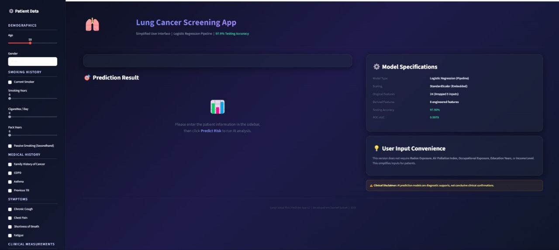
The Prediction Model
.

Slide 24
Project Roadmap & Deliverables
Number of Phase | Phase Name | Duration | Key Deliverables
Phase 1 | Project Planning & Data Preparation | Week 1 | Business understanding, dataset exploration, data cleaning, feature engineering, and data validation .
Phase 2 | Exploratory Data Analysis (EDA) | Week 2 | Statistical analysis , KPI definition , DAX planning and business insights identification .
Phase 3 | Dashboard Development | Week 3 & 4 | Development of the interactive power bi dashboard ( overview , smoking analysis , risk , Cancer insights pages )
Phase 4 | Machine Learning Development | Week 5 | Data preprocessing , model training , evaluation , prediction module , and performance testing .
Phase 5 | Website Development & Integration | Week 6 | Development of smoking Recovery website and integration with the prediction model .
Phase 6 | Testing, Documentation & Final Delivery | Week 7 & 8 | Dashboard testing , website testing , documentation , final presentation , and project deployment .
.

Slide 25
Recommendations
1-Prioritize the Most Vulnerable Age Group :
Patients aged 39–48 years represent the highest-risk age group in the dataset so the website will targeted in the first phase launch this age then in the second launch will launch other ages .2-Encourage Smoking Cessation :
Website should launch targeted smoking cessation programs, especially for heavy smokers .
3- Support Former Smokers :
Website should support and encourage more smokers to transition into former smokers through continuous follow-up .
.

Slide 26
Recommendations
4-Focus on Lung Health :
Patients with smoking history should undergo routine lung examinations and early screening before symptoms appear.
5- Family History Monitoring :
Patients with a family history require closer monitoring
6-Early Detection:
Website providers should prioritize preventive screening instead of waiting for symptoms to appear.
.

Slide 27
Other Recommendations for Website
7-Health Recovery Timeline .
8- Money Saved Calculator .
9- Challenge System to support smoker continue this journey.
10- AI Health Coach to ask chatbot for any help in the website .
11- Health Journey Map to monitors the patient's condition.
12- screening Reminder System to schedule medical screenings and routine check-ups.
.

Slide 28
Team Member :-
• Team leader : Yasmeen hassan
• Data engineering & cleaning : Esraa Ali
• Model & Website : Salma Yasser
• Design dashboard : Merola Medhat & Mohraiel Maher
Collaboration methods:-
• Zoom meeting
• WhatsApp & Telegram
• Share point
• Google Drive
.

Slide 29
Thank You
Thank you for your time and attention.
We appreciate the opportunity to present our project and share our vision for supporting smokers in achieving a healthier, smoke-free life.
Contact Information
📧 Email: yasmeenh359@gmail.com
💼 LinkedIn: https://www.linkedin.com/in/yasmeen-hassan-
🌐 GitHub: https://github.com/yasmeenh359-sketch
Questions & Feedback
We welcome your questions, comments, and valuable feedback.
Thank You!

